Slide 1
Chapter 13
WebApp Design
These slides are designed to accompany Software Engineering: A Practitioner’s Approach, 7/e (McGraw-Hill, 2009) Slides copyright 2009 by Roger Pressman.

Slide 2
Design & WebApp Quality
Design is the engineering activity that leads to a high-quality product.
Some users enjoy flashy graphics; others want simple text. Some demand copious information; others desire an abbreviated presentation. Some like sophisticated analytical tools or database access; others like to keep it simple.
These slides are designed to accompany Software Engineering: A Practitioner’s Approach, 7/e (McGraw-Hill, 2009) Slides copyright 2009 by Roger Pressman.

Slide 3
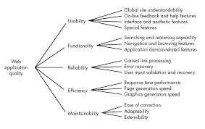
These slides are designed to accompany Software Engineering: A Practitioner’s Approach, 7/e (McGraw-Hill, 2009) Slides copyright 2009 by Roger Pressman.

Slide 4
Security. WebApps have become heavily integrated with critical corporate and government databases. E-commerce applications extract and then store sensitive
customer information.
Availability.
Even the best WebApp will not meet users’ needs if it is unavailable. In a technical sense, availability is the measure of the percentage of time that a WebApp is available for use. The typical end user expects WebApps to be available 24/7/365.
Using features available on only one browser or one platform” makes the WebApp unavailable to those with a different browser/platform configuration.
These slides are designed to accompany Software Engineering: A Practitioner’s Approach, 7/e (McGraw-Hill, 2009) Slides copyright 2009 by Roger Pressman.

Slide 5
Scalability. Can the WebApp and its server environment be scaled to handle 100,1000, 10,000, or 100,000 users?
Will the WebApp and the systems with which it is interfaced handle significant variation in volume or will responsiveness drop dramatically (or cease altogether)?
Time-to-market. The first WebApp to address a specific market segment often captures a disproportionate
number of end users.
These slides are designed to accompany Software Engineering: A Practitioner’s Approach, 7/e (McGraw-Hill, 2009) Slides copyright 2009 by Roger Pressman.

Slide 6
Design & WebApp Quality
Security
  Exclude external attacks
  Exclude unauthorized access
  Ensure the privacy of users/customers
Availability
  the measure of the percentage of time that a WebApp is available for use
Scalability
  Can the WebApp and the systems with which it is interfaced handle significant variation in user or transaction volume
Time to Market
These slides are designed to accompany Software Engineering: A Practitioner’s Approach, 7/e (McGraw-Hill, 2009) Slides copyright 2009 by Roger Pressman.

Slide 7
What should we consider when assessing content quality?
Can the scope and depth of content be easily determined to ensure that it meets the user’s needs?
Can the background and authority of the content’s authors be easily identified?
Is it possible to determine the currency of the content, the last update, and what was updated?
Are the content and its location stable (i.e., will they remain at the referenced URL)?
These slides are designed to accompany Software Engineering: A Practitioner’s Approach, 7/e (McGraw-Hill, 2009) Slides copyright 2009 by Roger Pressman.

Slide 8
Is content credible?
Is content unique? That is, does the WebApp provide some unique benefit to those who use it?
Is content valuable to the targeted user community?
Is content well organized? Indexed? Easily accessible?
These slides are designed to accompany Software Engineering: A Practitioner’s Approach, 7/e (McGraw-Hill, 2009) Slides copyright 2009 by Roger Pressman.

Slide 9
Quality Dimensions for End-Users
Time
  Specify date and time of creation and last changed.
Structural
  all of the parts of the Web site hold together.
  all links inside and outside the Web site working
  all of the images work
  Check any unwanted parts of the Web site
Content
  the content of critical pages should match with the context
  key phrases must exist
  pages should maintain quality content
  Context of the dynamically generated HTML pages content should maintain
These slides are designed to accompany Software Engineering: A Practitioner’s Approach, 7/e (McGraw-Hill, 2009) Slides copyright 2009 by Roger Pressman.

Slide 10
Quality Dimensions for End-Users
Accuracy and Consistency
  Like today's copies of the pages downloaded the same as yesterday's
  the data presented accurate enough
Response Time and Latency
  Does the Web site server respond to a browser request within certain parameters?
  In an E-commerce context, how is the end to end response time after a SUBMIT?
  Are there parts of a site that are so slow the user declines to continue working on it?
Performance
  Is the Browser-Web-Web site-Web-Browser connection quick enough?
  How does the performance vary by time of day, by load and usage?
  Is performance adequate for E-commerce applications?
These slides are designed to accompany Software Engineering: A Practitioner’s Approach, 7/e (McGraw-Hill, 2009) Slides copyright 2009 by Roger Pressman.

Slide 11
WebApp Design Goals
Simplicity.
There is a tendency among some designers to provide the end user with “too much”—exhaustive content, extreme visuals, intrusive animation, enormous Web pages, the list is long.
Better to strive for moderation and simplicity.
Content should be informative but succinct and should use a delivery mode (e.g., text, graphics, video, audio) that is appropriate to the information that is being delivered.
These slides are designed to accompany Software Engineering: A Practitioner’s Approach, 7/e (McGraw-Hill, 2009) Slides copyright 2009 by Roger Pressman.

Slide 12
WebApp Design Goals
Consistency
  Content should be constructed consistently
  Graphic design (aesthetics) should present a consistent look across all parts of the WebApp
  Architectural design should establish templates that lead to a consistent hypermedia structure
  Interface design should define consistent modes of interaction, navigation and content display
  Navigation mechanisms should be used consistently across all WebApp elements
These slides are designed to accompany Software Engineering: A Practitioner’s Approach, 7/e (McGraw-Hill, 2009) Slides copyright 2009 by Roger Pressman.

Slide 13
WebApp Design Goals
Identity
  Establish an “identity” that is appropriate for the business purpose
  A website for a hiphop group will undoubtedly have a different look and feel than a WebApp designed for a financial services company.
Robustness
  The user expects content and functions that are relevant to the user’s needs
Navigability
  Designed in a manner that is intuitive and predictable
  The user should understand how to move about the WebApp without having to search for navigation links or instructions.

Slide 14
Navigability
It is also important to position links to major WebApp content and functions in a predictable location on every Web page.
Visual appeal
  The look and feel of content, interface layout, color coordination, the balance of text, graphics and other media, navigation mechanisms must appeal to end-users
Compatibility
  With all appropriate environments and configurations
These slides are designed to accompany Software Engineering: A Practitioner’s Approach, 7/e (McGraw-Hill, 2009) Slides copyright 2009 by Roger Pressman.

Slide 15
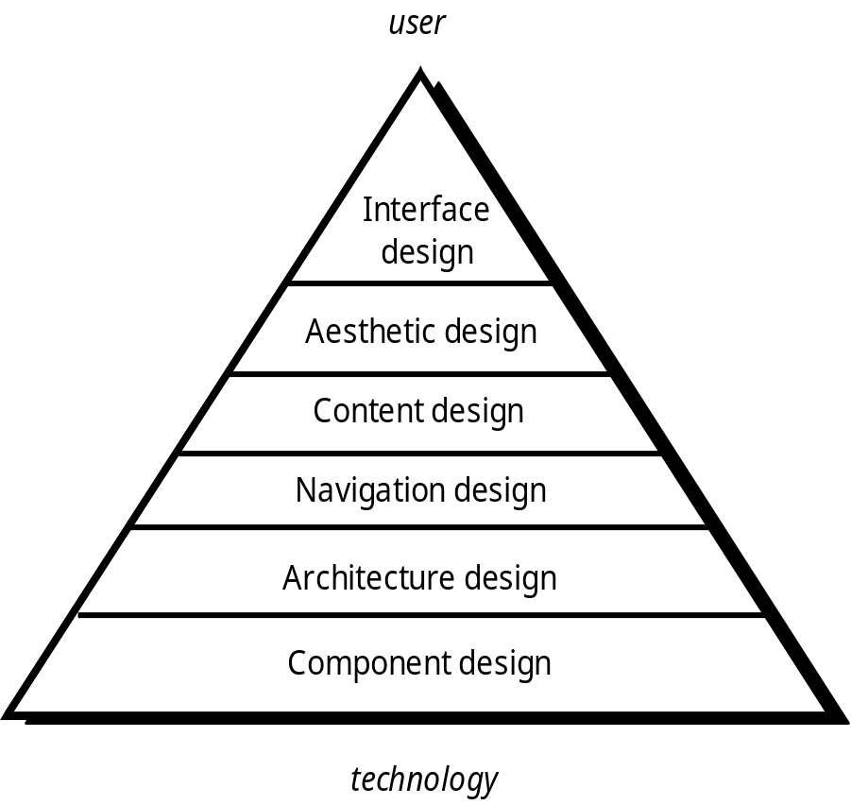
WebE Design Pyramid
These slides are designed to accompany Software Engineering: A Practitioner’s Approach, 7/e (McGraw-Hill, 2009) Slides copyright 2009 by Roger Pressman.

Slide 16
One of the challenges of interface design for WebApps is the indeterminate nature of the user’s entry point.
The WebApp design must provide interface navigation features that accompany all content objects and are available regardless of how the user enters the system.
The objectives of a WebApp interface are to: (1) establish a consistent window into the content and functionality provided by the interface,

Slide 17
(2) guide the user through a series of interactions with the WebApp, and
(3) organize the navigation options and content available to the user.
To achieve a consistent interface, you should first use aesthetic design to establish a coherent “look.”
To guide user interaction, you may draw on an appropriate metaphor that enables the user to gain an intuitive understanding of the interface.
These slides are designed to accompany Software Engineering: A Practitioner’s Approach, 7/e (McGraw-Hill, 2009) Slides copyright 2009 by Roger Pressman.

Slide 18
To implement navigation options :
Navigation menus—keyword menus organized vertically or horizontally) that list key content and/or functionality. These menus may be implemented so that the user can choose from a hierarchy of subtopics that is displayed when the primary menu option is selected.
Graphic icons—button, switches, and similar graphical images that enable the user to select some property or specify a decision.
Graphic images—some graphical representation that is selectable by the user and implements a link to a content object or WebApp functionality.
These slides are designed to accompany Software Engineering: A Practitioner’s Approach, 7/e (McGraw-Hill, 2009) Slides copyright 2009 by Roger Pressman.

Slide 19
Aesthetic Design
Aesthetic design, also called graphic design, is an artistic endeavor that complements the technical aspects of WebApp design. Without it, a WebApp may be functional, but unappealing.
Layout Issues:
Don’t be afraid of white space. - It is inadvisable to pack every square inch of a Web page with information.
Emphasize content. - the typical Web page should be 80 percent content with the remaining real estate dedicated to navigation and other features.

Slide 20
Organize layout elements from top-left to bottom right. - If layout elements have specific priorities, high-priority elements should be placed in the upper-left portion of the page real estate.
Group navigation, content, and function geographically within the page. - If there are no discernable patterns within a Web page, user frustration is likely to increase
These slides are designed to accompany Software Engineering: A Practitioner’s Approach, 7/e (McGraw-Hill, 2009) Slides copyright 2009 by Roger Pressman.

Slide 21
Don’t extend your real estate with the scrolling bar. - It is better to reduce page content or to present necessary content on
multiple pages.
Consider resolution and browser window size when designing layout - Rather than defining fixed sizes within a layout, the design should specify all layout items as a percentage of available space
These slides are designed to accompany Software Engineering: A Practitioner’s Approach, 7/e (McGraw-Hill, 2009) Slides copyright 2009 by Roger Pressman.

Slide 22
Graphic Design Issues
Graphic design considers every aspect of the look and feel of a WebApp.
The graphic design process begins with layout and proceeds into a consideration of global color schemes; text types, sizes, and styles; the use of supplementary media (e.g., audio, video, animation); and all other aesthetic elements of an application.
These slides are designed to accompany Software Engineering: A Practitioner’s Approach, 7/e (McGraw-Hill, 2009) Slides copyright 2009 by Roger Pressman.

Slide 23
Content Design
Develops a design representation for content objects
  For WebApps, a content object is more closely aligned with a data object for conventional software
Represents the mechanisms required to instantiate their relationships to one another.
  analogous to the relationship between analysis classes and design components .
A content object has attributes that include content-specific information and implementation-specific attributes that are specified as part of design
These slides are designed to accompany Software Engineering: A Practitioner’s Approach, 7/e (McGraw-Hill, 2009) Slides copyright 2009 by Roger Pressman.

Slide 24
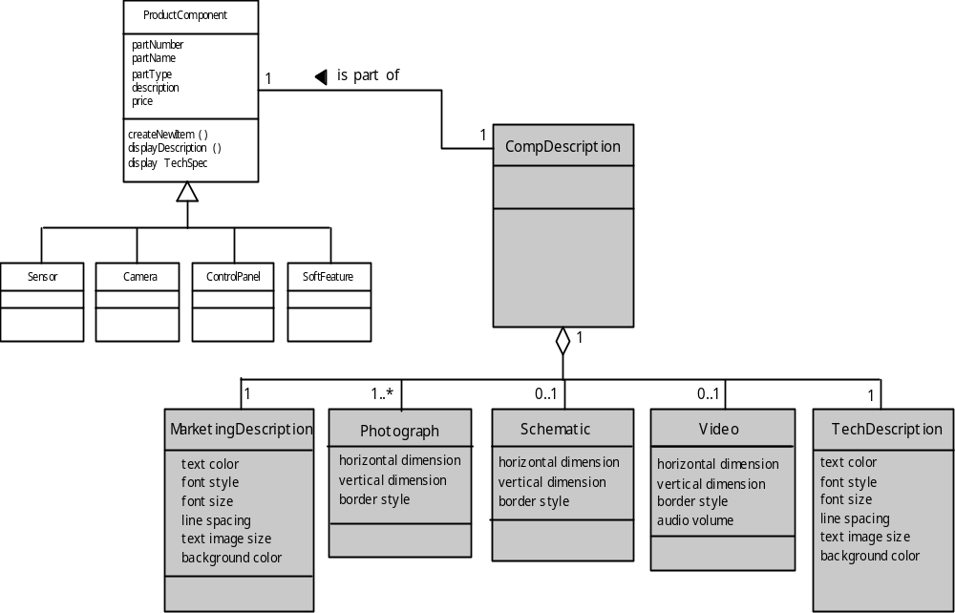
Design of Content Objects
These slides are designed to accompany Software Engineering: A Practitioner’s Approach, 7/e (McGraw-Hill, 2009) Slides copyright 2009 by Roger Pressman.

Slide 25
Content Design Issues
Once all content objects are modeled, the information that each object is to deliver
must be authored and then formatted to best meet the customer’s needs.
Content authoring is the job of specialists in the relevant area who design the content object by
providing an outline of information to be delivered and an indication of the types of
generic content objects.
These slides are designed to accompany Software Engineering: A Practitioner’s Approach, 7/e (McGraw-Hill, 2009) Slides copyright 2009 by Roger Pressman.

Slide 26
Architecture Design
Architecture design is tied to the goals established for a WebApp, the content to be presented, the users who will visit, and the navigation philosophy that has been established.
Content architecture focuses on the manner in which content objects (or composite objects such as Web pages) are structured for presentation and navigation.
WebApp architecture addresses the manner in which the application is structured to manage user interaction, handle internal processing tasks, effect navigation, and present content.
Architecture design is conducted in parallel with interface design, aesthetic design and content design.
These slides are designed to accompany Software Engineering: A Practitioner’s Approach, 7/e (McGraw-Hill, 2009) Slides copyright 2009 by Roger Pressman.

Slide 27
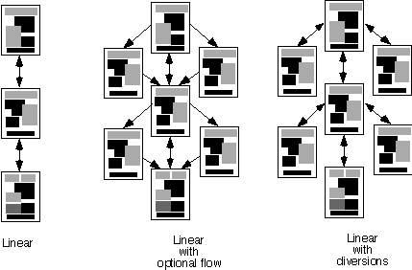
Content Architecture
Linear
structure
Grid
structure
These slides are designed to accompany Software Engineering: A Practitioner’s Approach, 7/e (McGraw-Hill, 2009) Slides copyright 2009 by Roger Pressman.

Slide 28
Linear structures
Linear structures are encountered when a predictable sequence of interactions (with some variation or diversion) is common.
A classic example might be a tutorial presentation in which pages of information along with related graphics, short videos, or audio are presented only after prerequisite information has been presented.
Another example might be a product order entry sequence in which specific information must be specified in a specific order.
These slides are designed to accompany Software Engineering: A Practitioner’s Approach, 7/e (McGraw-Hill, 2009) Slides copyright 2009 by Roger Pressman.

Slide 29
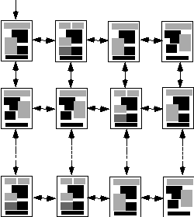
Grid Structures
These slides are designed to accompany Software Engineering: A Practitioner’s Approach, 7/e (McGraw-Hill, 2009) Slides copyright 2009 by Roger Pressman.

Slide 30
Grid structures
Grid structures are an architectural option that you can apply when WebApp content can be organized categorically in two (or more) dimensions.
For example, consider a situation in which an e-commerce site sells golf clubs.
The horizontal dimension of the grid represents the type of club to be sold (e.g., woods, irons, wedges, putters).
The vertical dimension represents the offerings provided by various golf club manufacturers. Hence, a user might navigate the grid horizontally to find the putters column and then vertically to examine the offerings provided by
those manufacturers that sell putters.
This WebApp architecture is useful only when highly regular content is encountered

Slide 31
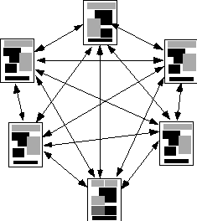
Hierarchical structures
These slides are designed to accompany Software Engineering: A Practitioner’s Approach, 7/e (McGraw-Hill, 2009) Slides copyright 2009 by Roger Pressman.

Slide 32
Hierarchical structures
Hierarchical structures are undoubtedly the most common WebApp architecture.
A WebApp hierarchical structure can be designed in a manner that enables (via hypertext branching) flow of control horizontally across vertical branches of the structure.
Hence, content presented on the far left-hand branch of the hierarchy can have hypertext links that lead directly to content that exists in the middle or right-hand branch of the structure.
It can lead to confusion on the part of the user.
These slides are designed to accompany Software Engineering: A Practitioner’s Approach, 7/e (McGraw-Hill, 2009) Slides copyright 2009 by Roger Pressman.

Slide 33
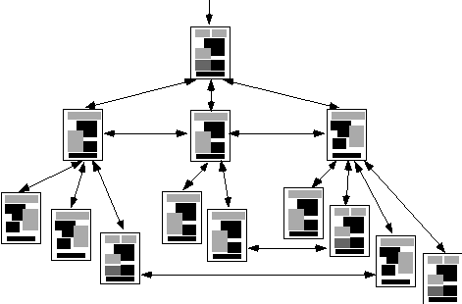
Network Structure
These slides are designed to accompany Software Engineering: A Practitioner’s Approach, 7/e (McGraw-Hill, 2009) Slides copyright 2009 by Roger Pressman.

Slide 34
Network Structure
A networked or “pure web” structure is similar in many ways to the architecture that evolves for object-oriented systems.
Architectural components are designed so that they may pass control (via hypertext links) to virtually every other component in the system.
This approach allows considerable navigation flexibility, but at the same time, can be confusing to a user.
These slides are designed to accompany Software Engineering: A Practitioner’s Approach, 7/e (McGraw-Hill, 2009) Slides copyright 2009 by Roger Pressman.

Slide 35
Composite Structure
The overall architecture of a WebApp may be
hierarchical, but part of the structure may exhibit linear characteristics, while another part of the architecture may be networked.
These slides are designed to accompany Software Engineering: A Practitioner’s Approach, 7/e (McGraw-Hill, 2009) Slides copyright 2009 by Roger Pressman.

Slide 36
WebApp Architecture
WebApp architecture describes an infrastructure that enables a Web-based system or application to achieve its business objectives.
The Model-View-Controller (MVC) architecture is one of a number of suggested WebApp infrastructure models that decouple the user interface from the WebApp functionality and informational content.
These slides are designed to accompany Software Engineering: A Practitioner’s Approach, 7/e (McGraw-Hill, 2009) Slides copyright 2009 by Roger Pressman.

Slide 37
MVC Architecture
The model contains all application specific content and processing logic, including
  all content objects
  access to external data/information sources,
  all processing functionality that are application specific
The view contains all interface specific functions and enables
  the presentation of content and processing logic
  access to external data/information sources,
  all processing functionality required by the end-user.
The controller manages access to the model and the view and coordinates the flow of data between them.

Slide 38
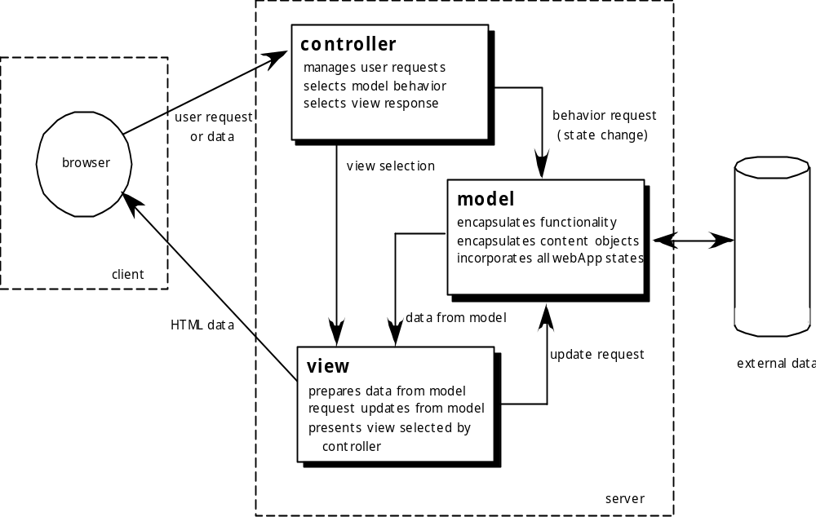
MVC Architecture
These slides are designed to accompany Software Engineering: A Practitioner’s Approach, 7/e (McGraw-Hill, 2009) Slides copyright 2009 by Roger Pressman.

Slide 39
User requests or data are handled by the controller. The controller also selects the view object that is applicable based on the user request.
Once the type of request is determined, a behavior request is transmitted to the model, which implements the functionality or retrieves the content required to accommodate the request.
The model object can access data stored in a corporate database, as part of a local data store, or as a collection of independent files.
The data developed by the model must be formatted and organized by the appropriate view object and then
transmitted from the application server back to the client-based browser for display on the customer’s machine.

Slide 40
Navigation Design
Begins with a consideration of the user hierarchy and related use-cases
  Each actor may use the WebApp somewhat differently and therefore have different navigation requirements
As each user interacts with the WebApp, she encounters a series of navigation semantic units (NSUs)
  NSU—“a set of information and related navigation structures that collaborate in the fulfillment of a subset of related user requirements”
These slides are designed to accompany Software Engineering: A Practitioner’s Approach, 7/e (McGraw-Hill, 2009) Slides copyright 2009 by Roger Pressman.

Slide 41
Navigation Semantic Units
Navigation semantic unit
  Ways of navigation (WoN)—represents the best navigation way or path for users with certain profiles to achieve their desired goal or sub-goal. Composed of …
    Navigation nodes (NN) connected by Navigation links
link₁₂
NN₂
link₂₄
NN₁
NN₄
NSU
link₁₃
NN₃
link₃₄
These slides are designed to accompany Software Engineering: A Practitioner’s Approach, 7/e (McGraw-Hill, 2009) Slides copyright 2009 by Roger Pressman.

Slide 42
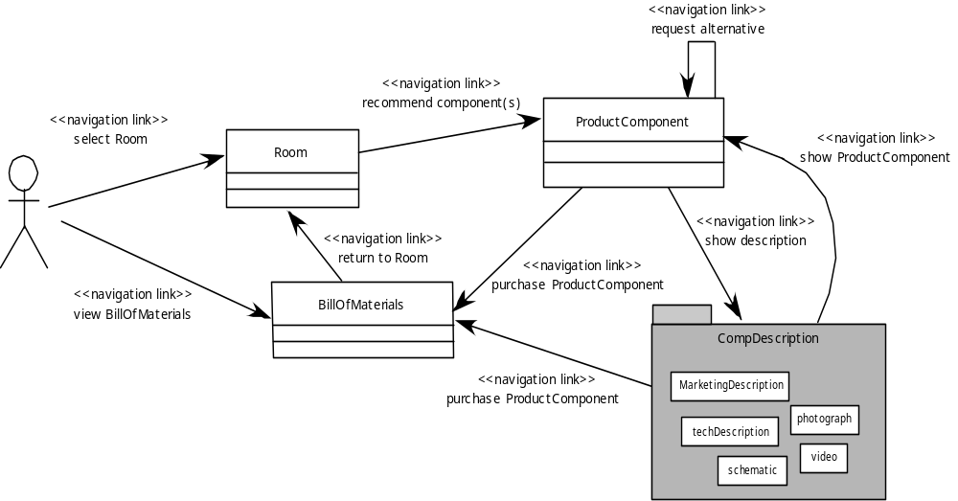
Creating an NSU
These slides are designed to accompany Software Engineering: A Practitioner’s Approach, 7/e (McGraw-Hill, 2009) Slides copyright 2009 by Roger Pressman.

Slide 43
Navigation Syntax
Individual navigation link—text-based links, icons, buttons and switches, and graphical metaphors..
Horizontal navigation bar—lists major content or functional categories in a bar containing appropriate links. In general, between 4 and 7 categories are listed.
Vertical navigation column
  lists major content or functional categories
  lists virtually all major content objects within the WebApp.
Tabs—a metaphor that is nothing more than a variation of the navigation bar or column, representing content or functional categories as tab sheets that are selected when a link is required.
Site maps—provide an all-inclusive tab of contents for navigation to all content objects and functionality contained within the WebApp.
These slides are designed to accompany Software Engineering: A Practitioner’s Approach, 7/e (McGraw-Hill, 2009) Slides copyright 2009 by Roger Pressman.

Slide 44
Component-Level Design
WebApp components implement the following functionality
  perform localized processing to generate content and navigation capability in a dynamic fashion
  provide computation or data processing capability that are appropriate for the WebApp’s business domain
  provide sophisticated database query and access
  establish data interfaces with external corporate systems.
These slides are designed to accompany Software Engineering: A Practitioner’s Approach, 7/e (McGraw-Hill, 2009) Slides copyright 2009 by Roger Pressman.

Slide 45
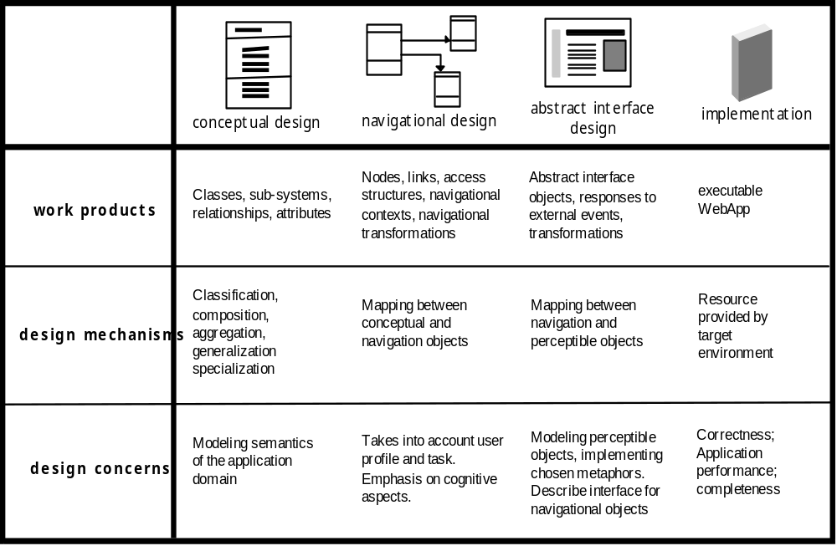
OOHDM
Object-Oriented Hypermedia Design Method (OOHDM)
These slides are designed to accompany Software Engineering: A Practitioner’s Approach, 7/e (McGraw-Hill, 2009) Slides copyright 2009 by Roger Pressman.

Slide 46
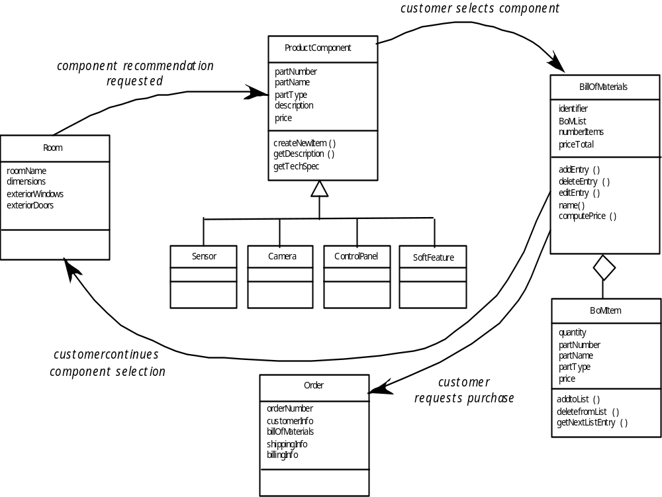
Conceptual Schema
These slides are designed to accompany Software Engineering: A Practitioner’s Approach, 7/e (McGraw-Hill, 2009) Slides copyright 2009 by Roger Pressman.

